Slide 1
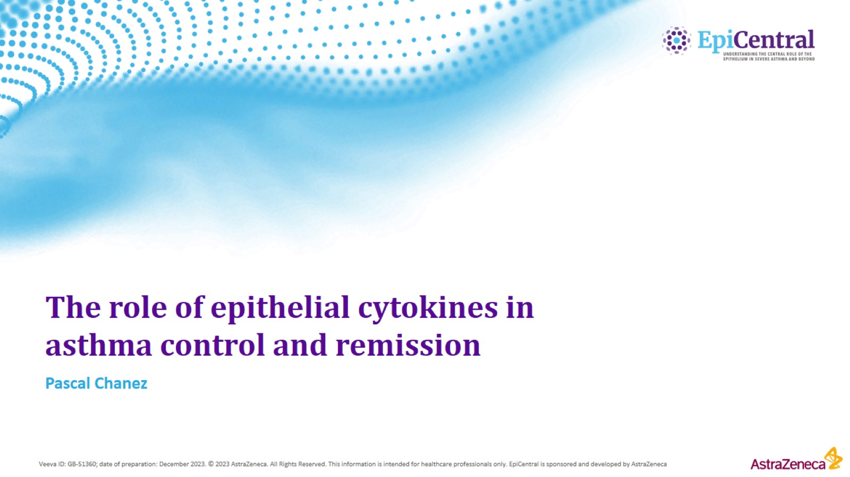
The role of epithelial cytokines in asthma control and remission

Slide 2
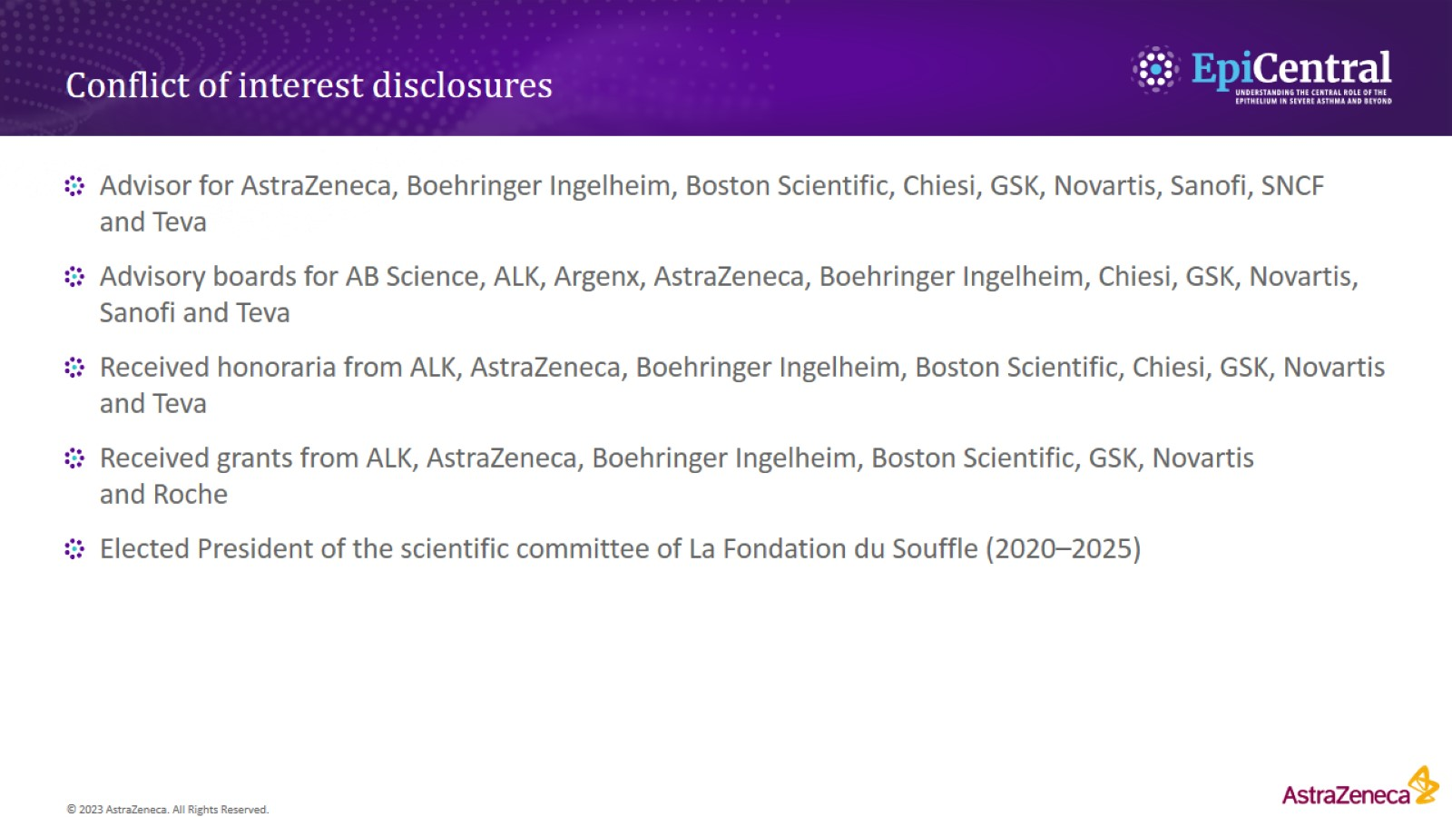
Conflict of interest disclosures

Slide 3
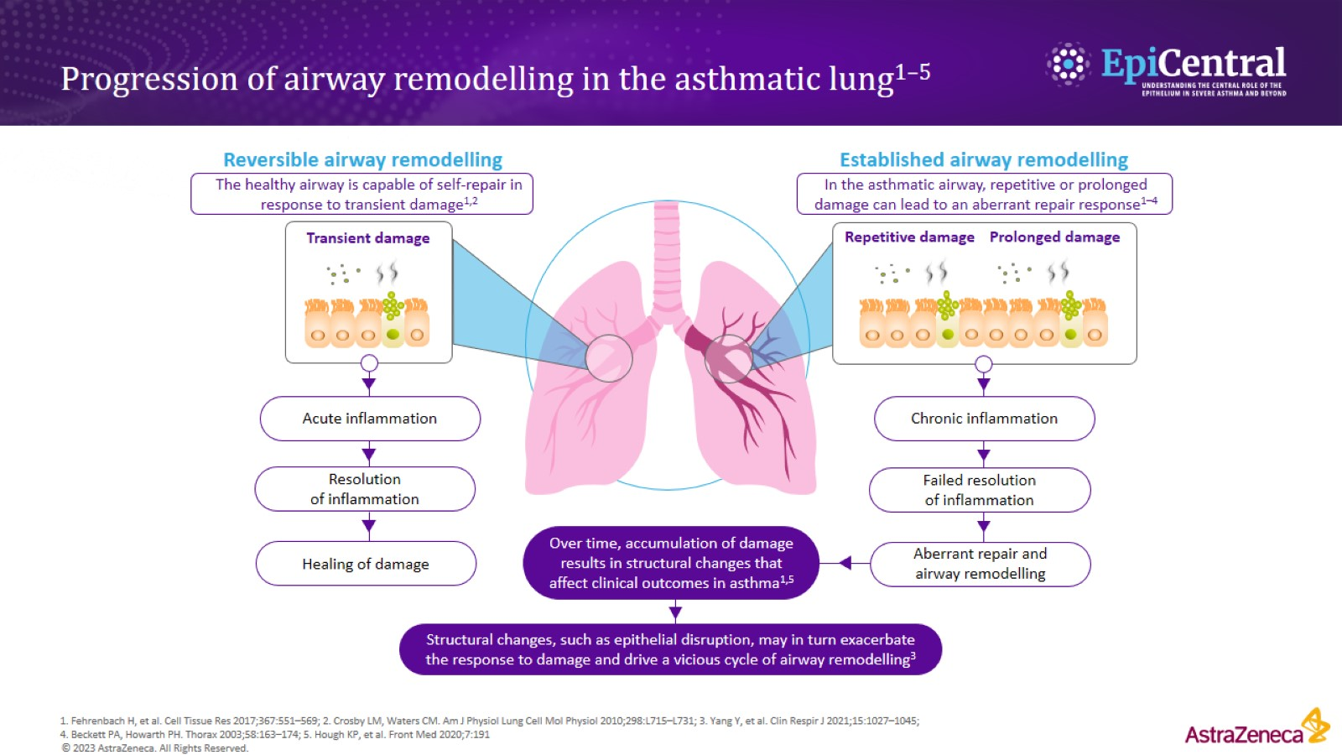
Progression of airway remodelling in the asthmatic lung^{1–5}

Slide 4
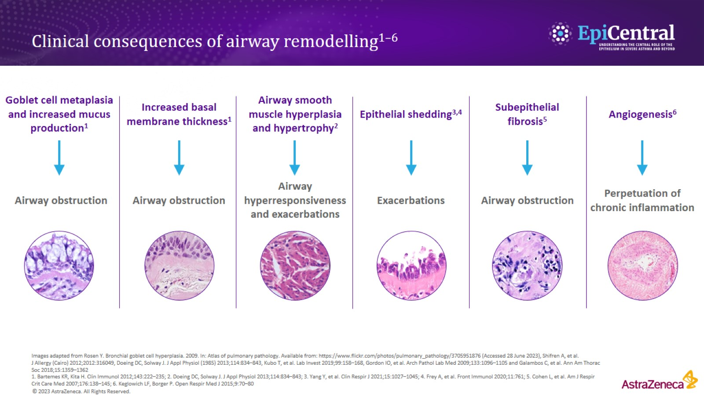
Clinical consequences of airway remodelling^{1–6}

Slide 5
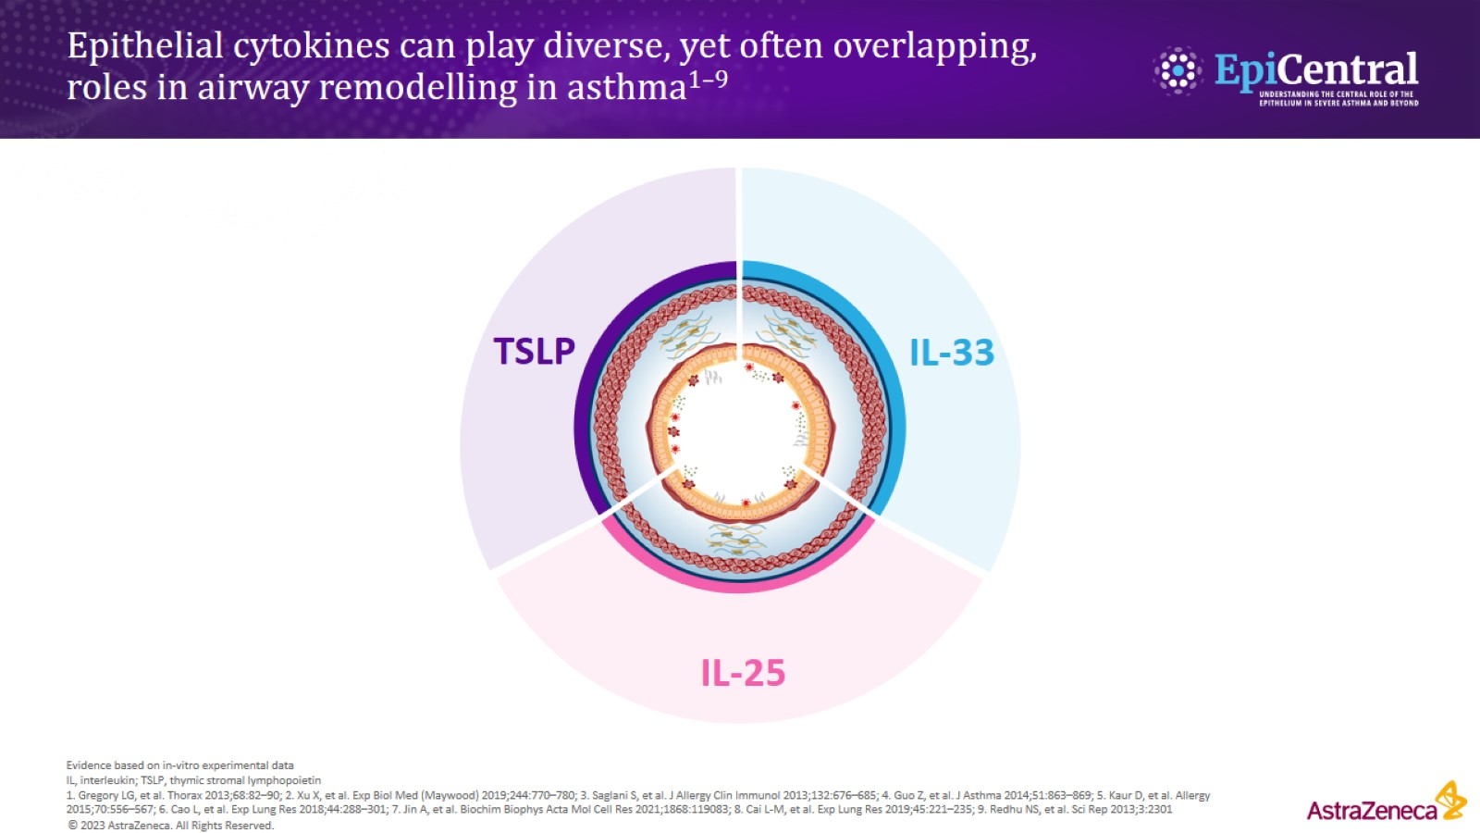
Epithelial cytokines can play diverse, yet often overlapping, roles in airway remodelling in asthma^{1–9}

Slide 6
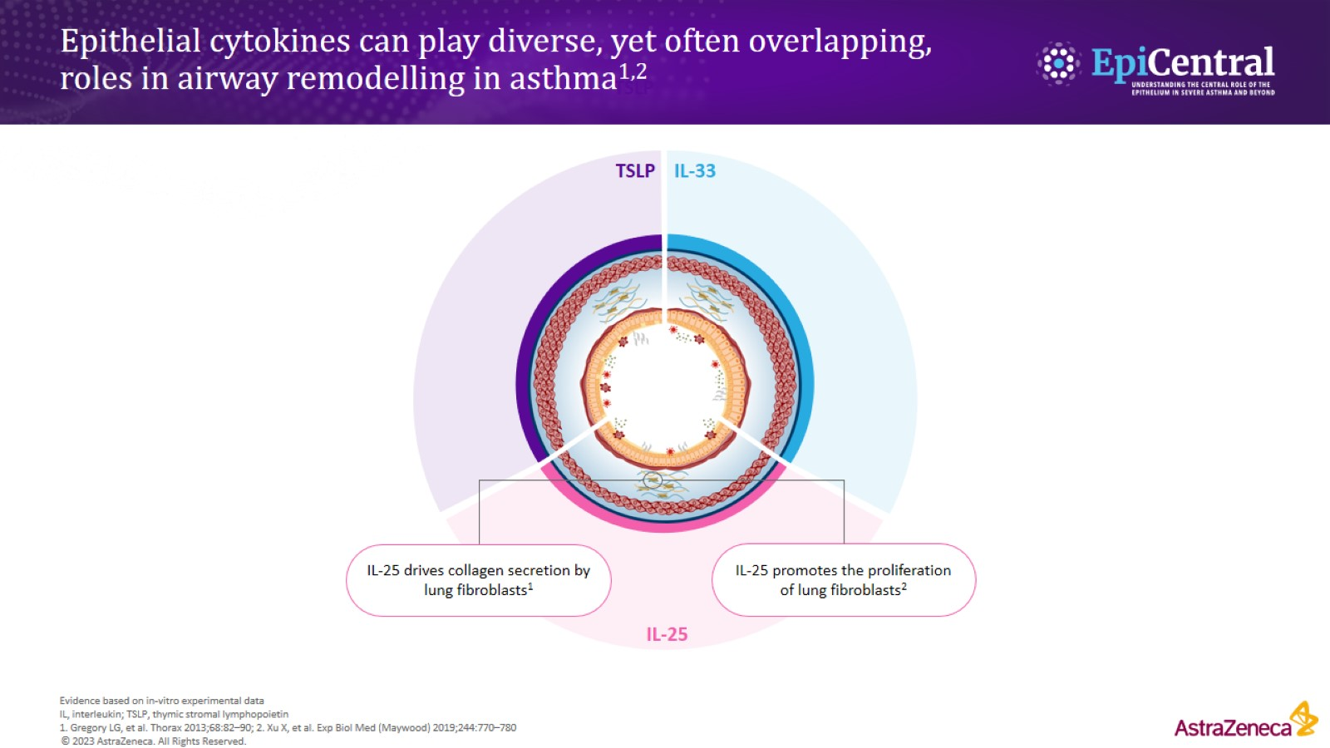
Epithelial cytokines can play diverse, yet often overlapping, roles in airway remodelling in asthma^{1,2}

Slide 7
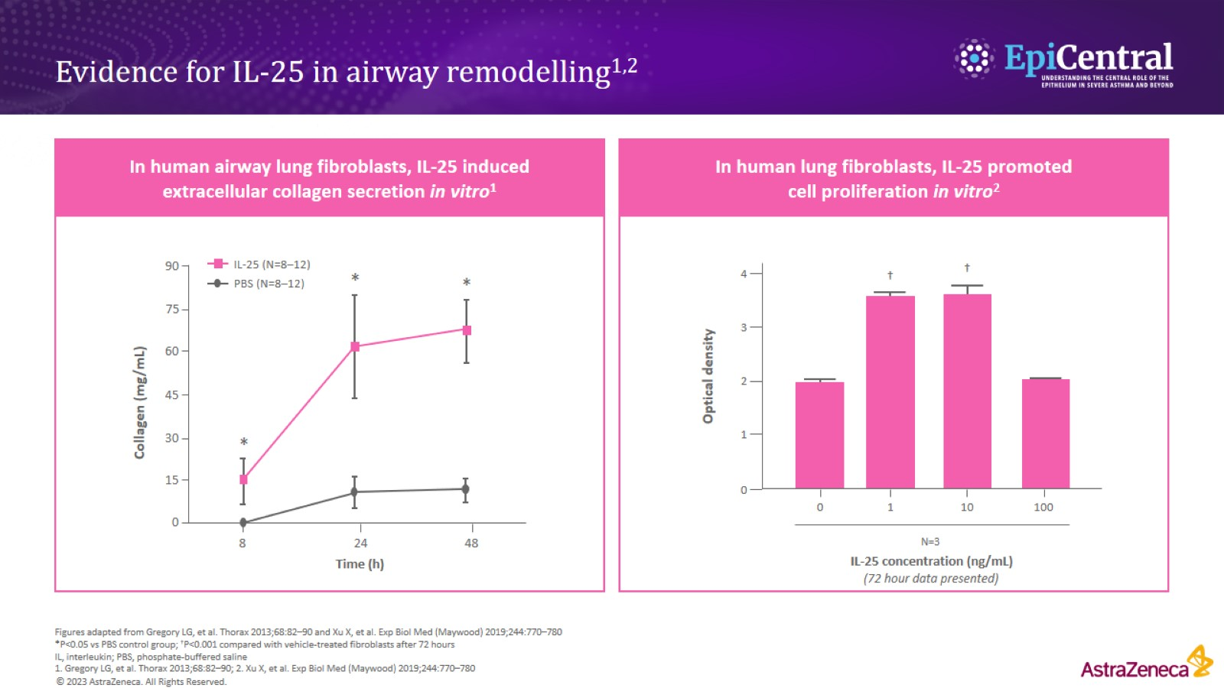
Evidence for IL-25 in airway remodelling^{1,2}

Slide 8
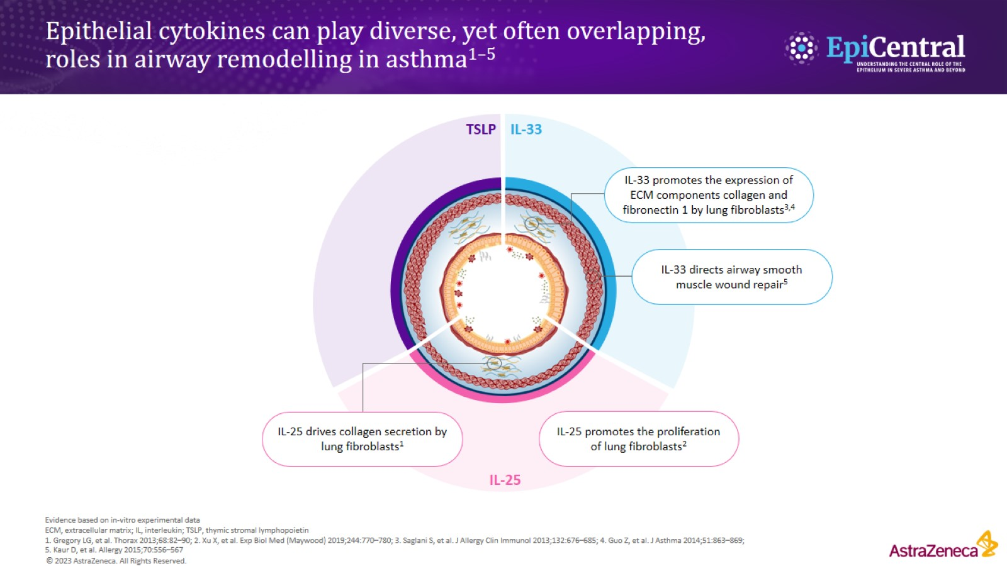
Epithelial cytokines can play diverse, yet often overlapping, roles in airway remodelling in asthma^{1–5}

Slide 9
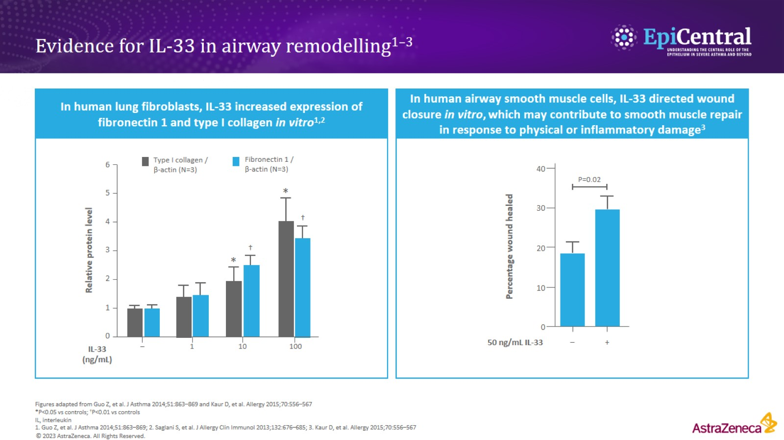
Evidence for IL-33 in airway remodelling^{1–3}

Slide 10
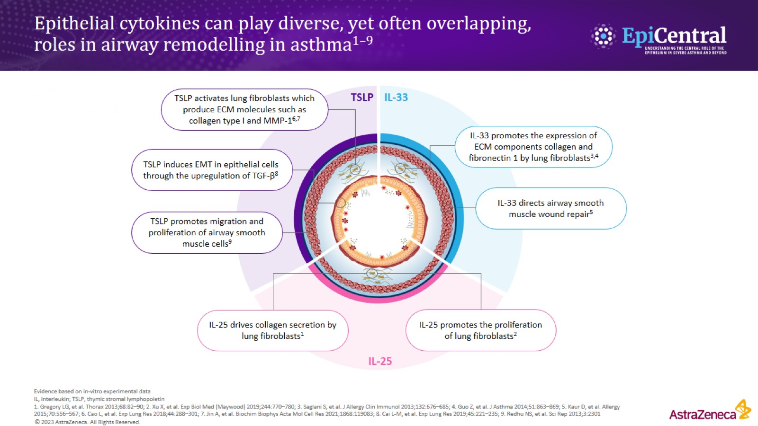
Epithelial cytokines can play diverse, yet often overlapping, roles in airway remodelling in asthma^{1–9}

Slide 11
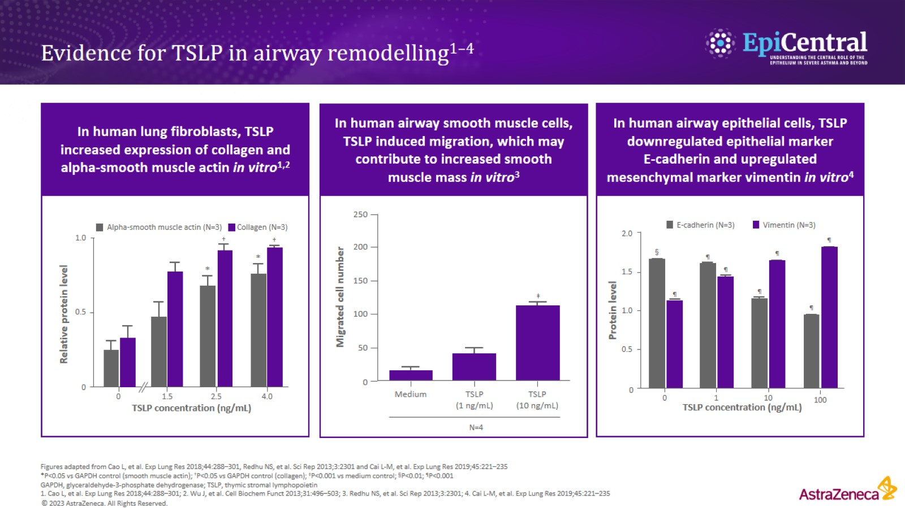
Evidence for TSLP in airway remodelling^{1–4}

Slide 12
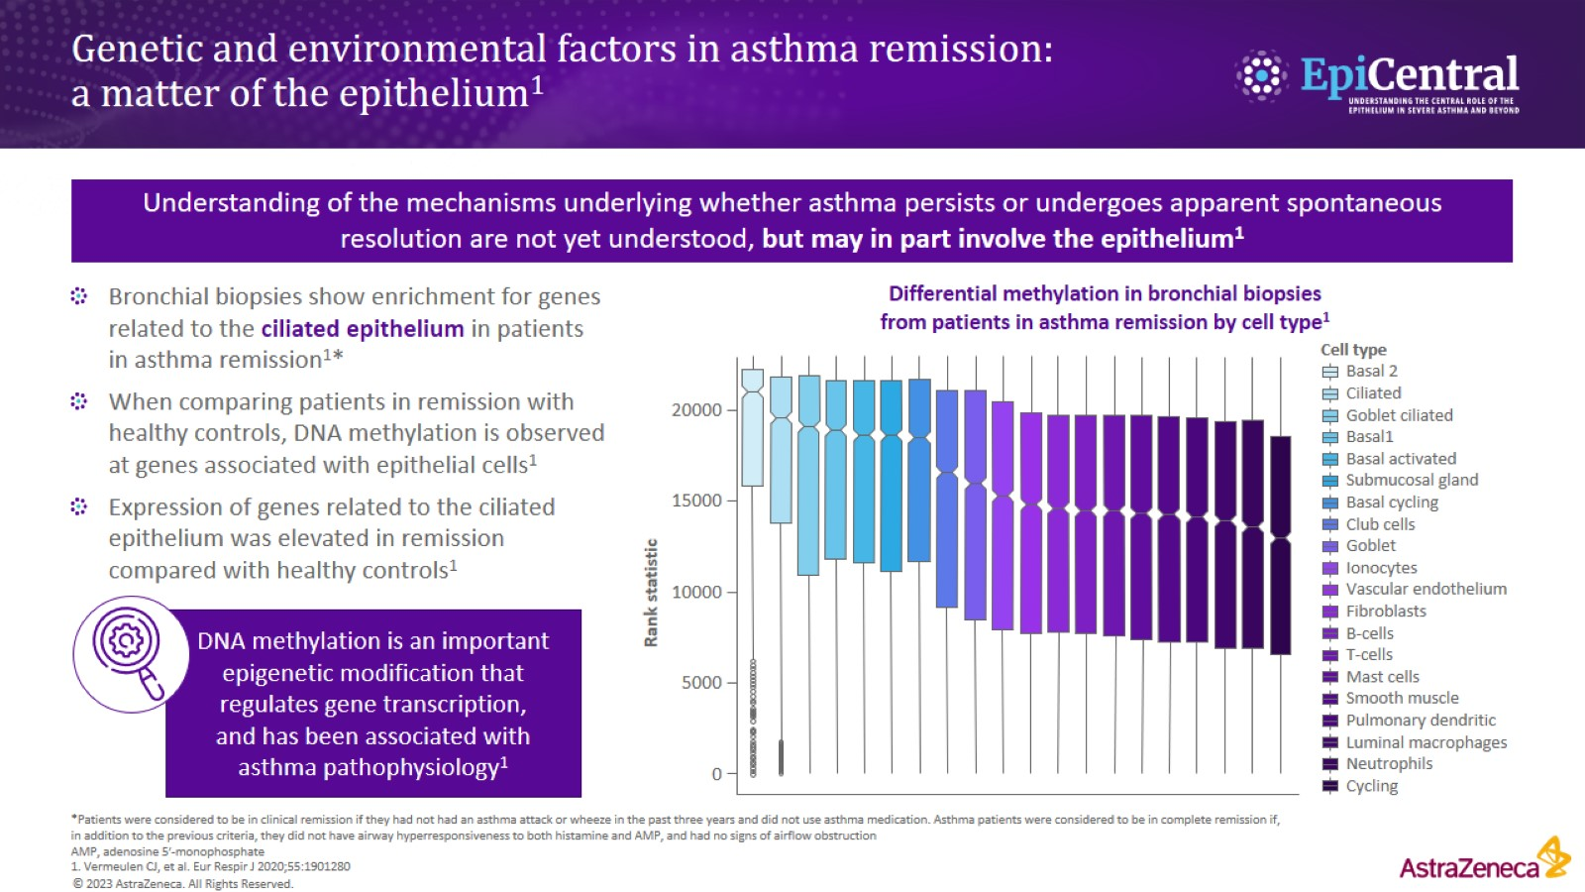
Genetic and environmental factors in asthma remission: a matter of the epithelium¹

Slide 13
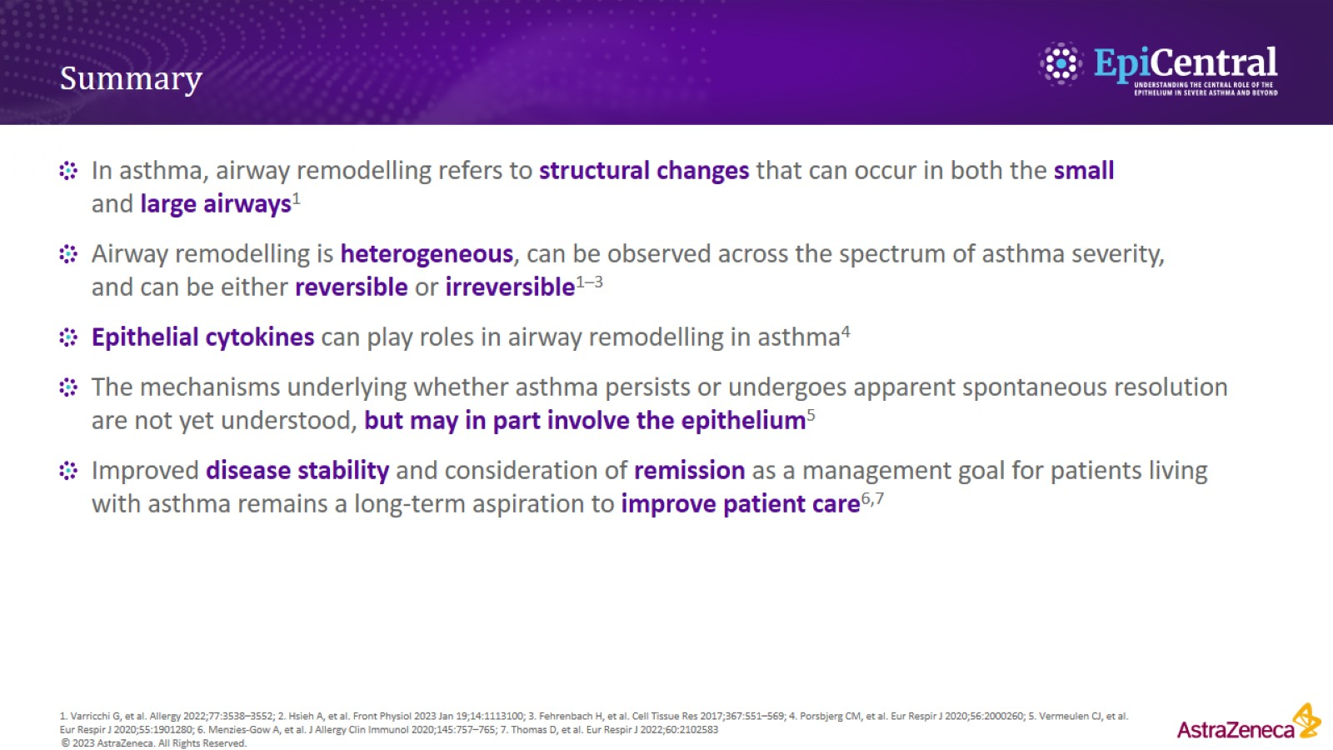
Summary

Slide 14
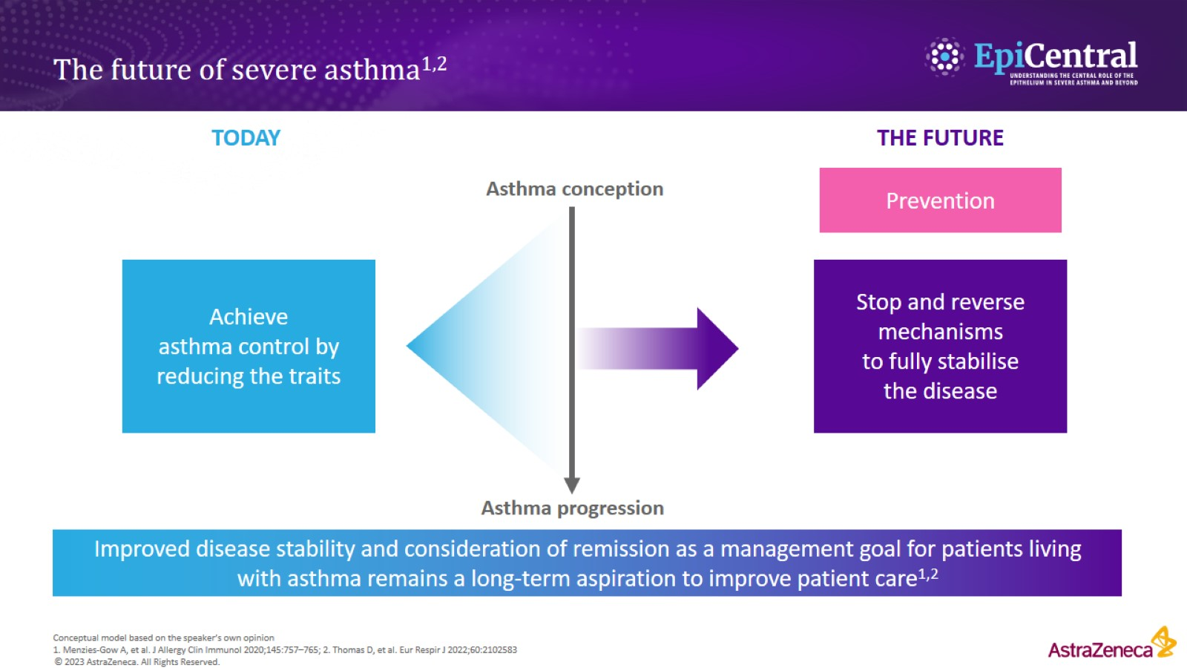
The future of severe asthma^{1,2}

